Slide 1
Housing: Price Prediction
Presentation On

Slide 2
Agenda
Overview.
Problem Statement.
Problem Understanding.
What is Housing Price Prediction?
Importance of housing price prediction.
Exploratory data analysis.
Visualizations.
Analysis.

Slide 3
Agenda
Data cleaning steps.
Model Building.
Hyper Parameter Tuning.
Saving the model and predictions from saved best model.
Conclusion.

Slide 4
Overview
In this particular presentation we will be looking on:
How to analyze the dataset on “Housing: Price Prediction”.
What are the EDA steps in cleaning the dataset?
Overall analysis on the problem.
Model building from train dataset.
Predicting Housing Price for test dataset.

Slide 5
Problem Statement
A US-based housing company named Surprise Housing has decided to enter the Australian market. The company uses data analytics to purchase houses at a price below their actual values and flip them at a higher price. For the same purpose, the company has collected a data set from the sale of houses in Australia. The data is provided in the CSV file below.

Slide 6
Problem Statement
The company is looking at prospective properties to buy houses to enter the market. You are required to build a model using Machine Learning in order to predict the actual value of the prospective properties and decide whether to invest in them or not. For this company wants to know:
Which variables are important to predict the price of variable?
How do these variables describe the price of the house?

Slide 7
Problem Understanding
House price prediction can help the developer determine the selling price of a house and can help the customer to arrange the right time to purchase a house.
Earlier, House prices were determined by calculating the acquiring price and selling price in a locality. Therefore, the House Price prediction model is very essential in filling the information gap and improve Real Estate efficiency.

Slide 8
Problem Understanding
Data science comes as a very important tool to solve problems in the domain to help the companies increase their overall revenue, profits, improving their marketing strategies and focusing on changing trends in house sales and purchases.
The aim is to predict the efficient house pricing for real estate customers with respect to their budgets and priorities. By analysing previous market trends and price ranges, and also upcoming developments, future prices, the cost of property is determined.

Slide 9
What is Housing Price Prediction?
The relationship between house prices and the economy is an important motivating factor for predicting house prices.The house price prediction helps the people to understand and know about the future price of the house.
Prediction of house prices are expected to help people who plan to buy a house, property investors, to know the price range in the future, then they can plan their finance well.

Slide 10
Importance of Housing Price Prediction
House Price prediction, is important to drive Real Estate efficiency.
Prediction house prices are expected to help people who plan to buy a house so they can know the price range in the future, then they can plan their finance well.
Predicting house prices can help to determine the selling price of a house of a particular region.
An increase in prices may lead to an improvement in the consumer confidence of homeowners which might then cause a rise in consumer spending

Slide 11
Exploratory Data Analysis
First step was importing the required libraries, then I imported both the datasets which were in csv format.
Then, I did all the basic statistical analysis like checking shape, column names, data types of each column, nunique, value counts, info etc.
While checking the info of the datasets I found columns with more than 80% null values, since these columns would create skewness in the datasets so I decided to drop these columns.

Slide 12
Exploratory Data Analysis
Then while looking into the value counts, I found some columns with more than 85% zero values, this would also creates skewness in the model and there are chances of getting model bias, so I dropped the columns with more than 85% zero values.
While checking for null values I found null values in most of the columns and I have used imputation method to replace those null values (mode for categorical column and mean for numerical columns).

Slide 13
Exploratory Data Analysis
In Id and Utilities column the unique counts were 1168 and 1 respectively, which means all the entries in Id column are unique and all the entries in Utilities column were the same, so these two column would not help us in model building. So I decided to drop the columns.
Next as a part of feature extraction I converted all the year columns to there respective age, assuming that age will help us more than year.
And all these steps were performed separately & simultaneously on the train and test datasets.

Slide 14
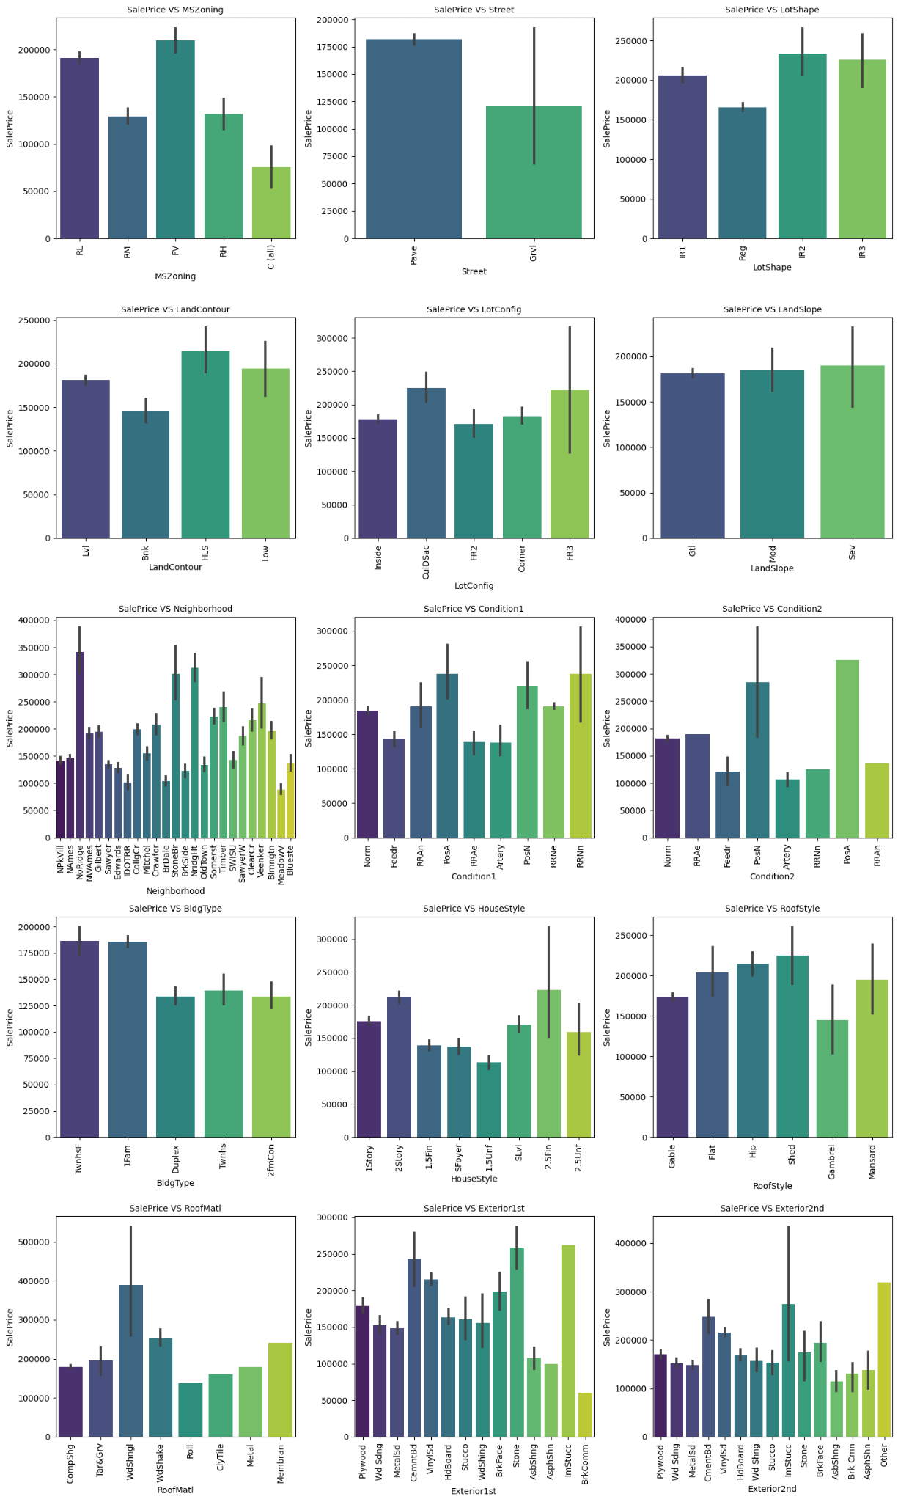
xx%
VISUALIZATION OF CATEGORICAL FEATURES

Slide 15
xx%
SalePrice vs MSZoning: Most of the houses belong to Floating Village Residential followed by Residential Low Density. The houses from this zone have high sale price compared to other zones.
SalePrice vs Street: By observing the bar plot, it is obvious that the property of house with Paved type of road have high SalePrice and the the houses in gravel roads have very less sale price.
SalePrice vs LotShape: Most of the houses having moderately irregular and irregular shape of property have high sale price and houses with regular type of property have less sale price compared to others.
SalePrice vs LandContour: The houses having the hillside and depression property flatness have high sale prices compared to others.
SalePrice vs LotConfig: Most of the houses with Frontage on 3 sides of property have high sale prices compared to others.
SalePrice vs LandSlope: There is no significant difference between the slope of the property. As we can observe the houses having Gentle slope, Moderate Slope and Severe Slope have the same sale price.
OBSERVATION

Slide 16
xx%
VISUALIZATION OF CATEGORICAL FEATURES

Slide 17
xx%
SalePrice vs Neighborhood: The houses which are located near Northridge have high sale prices compared to others.
SalePrice vs Condition1: The houses having the conditions adjacent to positive off-site features and houses within 200' of North-South Railroad have high sale price compared to others.
SalePrice vs Condition2: The houses having the conditions near positive off-site feature park, greenbelt, etc and adjacent to positive off-site feature have high sale price.
SalePrice vs BldgType: Most of the houses are Single-family Detached and Townhouse End Unit and they have higher sale price compared to other categories.
SalePrice vs HouseStyle: Houses which are having style of dwelling 2nd level finished and Two story have high sale price compared to other types.
SalePrice vs RoofStyle: The houses having the roof style Flat, Hip and Shed have high sale price and the houses having gambrel roof style have less sale price.
OBSERVATIONS

Slide 18
xx%
VISUALIZATION OF CATEGORICAL FEATURES

Slide 19
xx%
SalePrice vs RoofMatl: Houses with Wood Shingles roof materials have high sale prices.
SalePrice vs Exterior1st: Houses having Imitation Stucco, Stone and Cement Board as 1st exterior cover have high sale price.
SalePrice vs Exterior2nd: Houses having Imitation Stucco and others as 2nd cover have high sale prices.
OBSERVATIONS

Slide 20
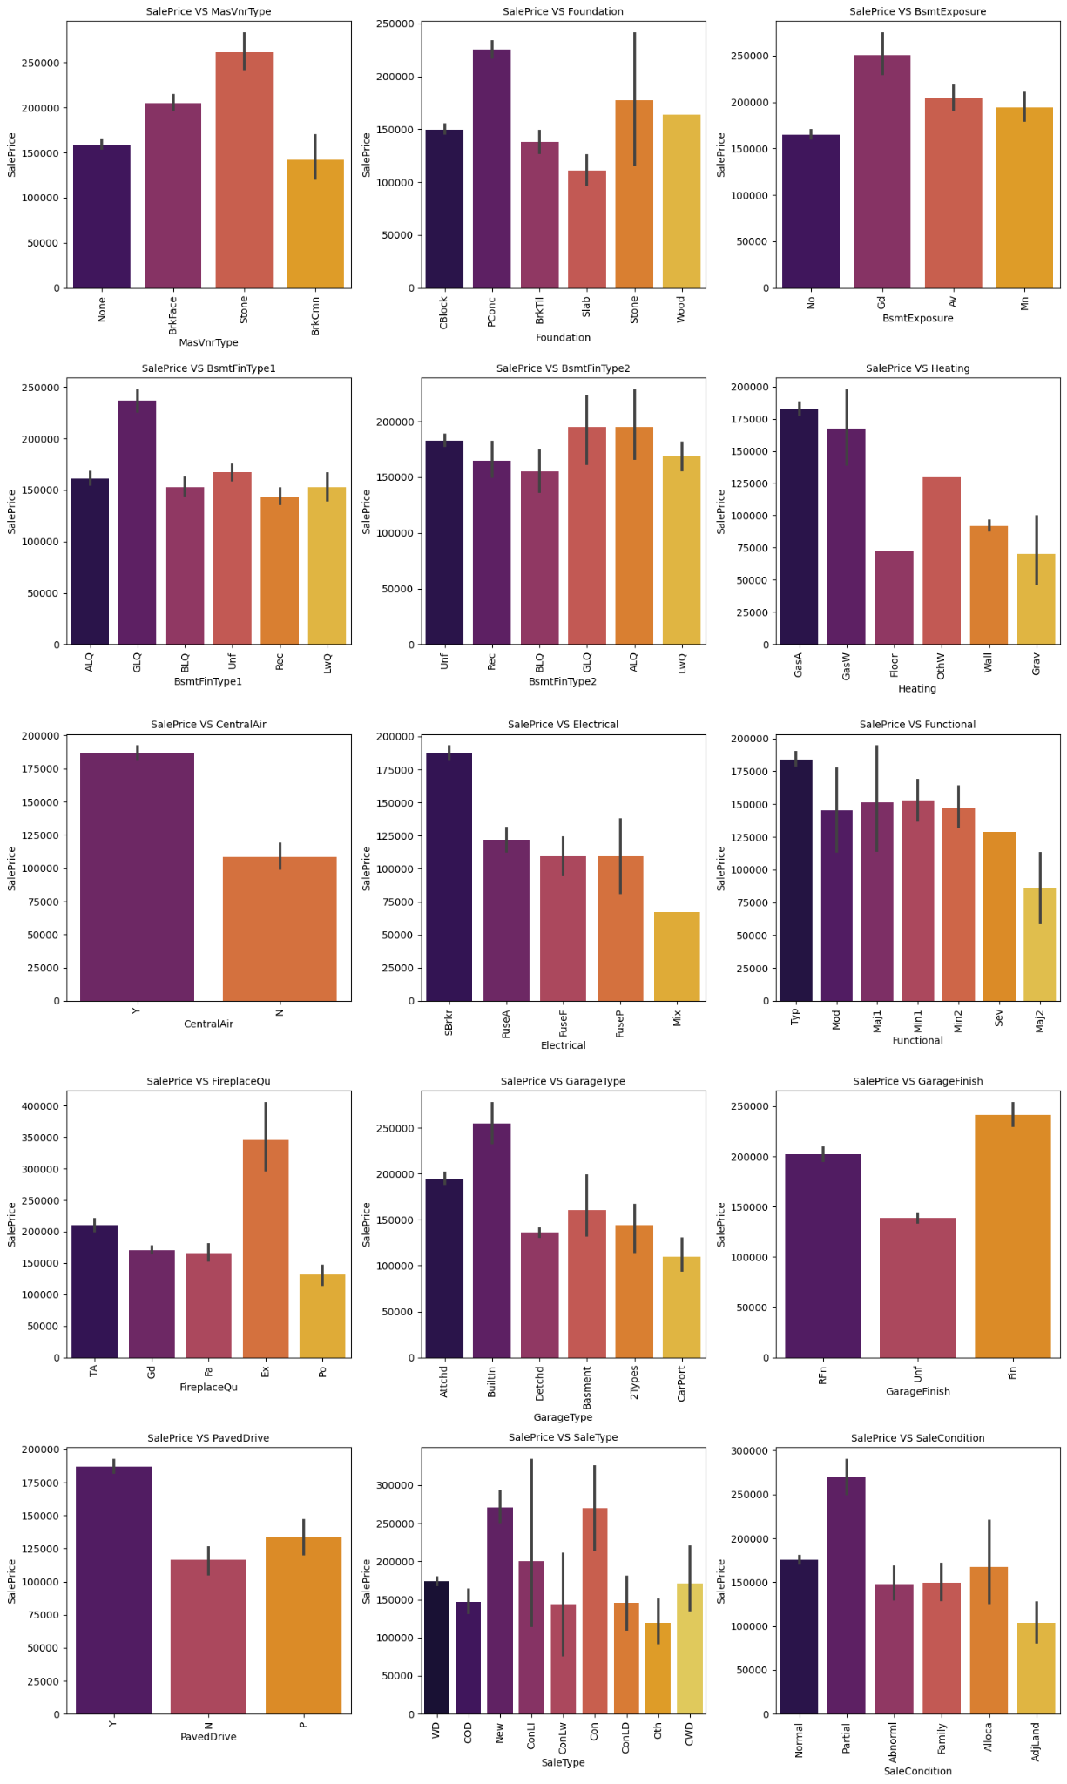
VISUALIZATION OF CATEGORICAL COLUMNS

Slide 21
SalePrice vs MasVnrType: Houses having Stone Masonry veneer type have high sale price than other types.
SalePrice vs Foundation: Houses having Poured Concrete as foundation type have high sale prices compared to other types.
SalePrice vs BsmtExposure: Houses having good walkout or garden level walls have high sale prices compared to others.
SalePrice vs BsmtFinType1: The sale price is high for the houses containing good living quarters and basement finished area.
SalePrice vs BsmtFinType2: The sale price is moderately high for the houses having good living quarters and average living quarters.
SalePrice vs Heating: The houses having the heating type gas forced warm air furnace and gas hot water or steam heat have high sale price.
OBSERVATIONS

Slide 22
VISUALIZATION OF CATEGORICAL COLUMNS

Slide 23
SalePrice vs CentralAir: Most of the houses have central air conditioning so it is obvious that these houses have high sale prices.
SalePrice vs Electrical: Most of the houses having standard circuit breakers & romex have high sale price compared to others.
SalePrice vs Functional: The houses having the typical functionality have maximum sales price and others have average sale price.
SalePrice vs FireplaceQu: The houses having excellent exceptional masonry fireplace quality have high sale price and the houses having poor fireplace quality have very less sale price compared to others.
SalePrice vs GarageType: The houses having built-in garage have high sale price compared to others.
SalePrice vs GarageFinishv: Garages located inside the house which is finished have a high sale price.
OBSERVATIONS

Slide 24
VISUALIZATION OF CATEGORICAL COLUMNS

Slide 25
SalePrice vs PavedDrive: Houses having paved driveways have high sale prices.
SalePrice vs SaleType: Many houses having sale types as just constructed and sold and Contract 15 % Down payment regular terms have high sale prices.
SalePrice vs SaleCondition: Houses having partial sale condition that is home was not completed when last assessed have high sale price.
OBSERVATIONS

Slide 26
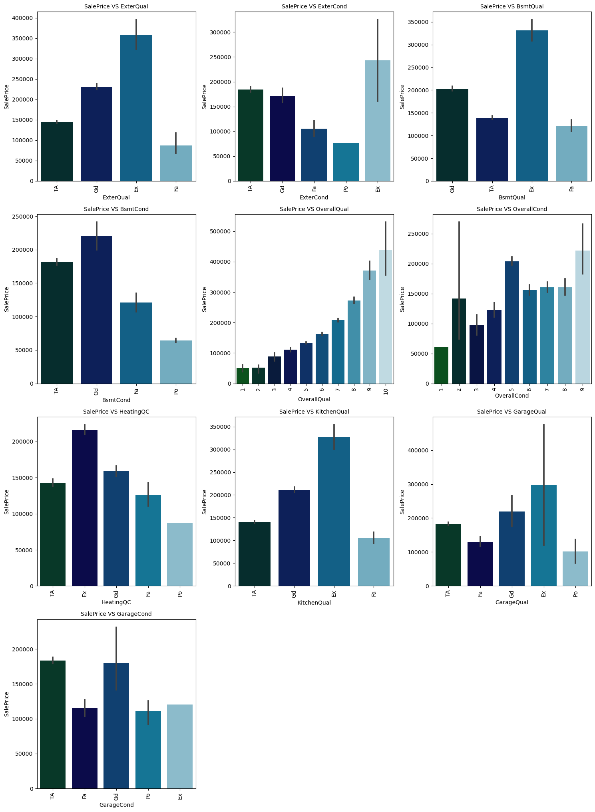
VISUALIZATION OF CATEGORICAL COLUMNS

Slide 27
SalePrice vs ExterQual: Houses having excellent quality of the material on the exterior have high sale price and houses having fair quality have very less sale price.
SalePrice vs ExterCond: Houses having excellent condition of the material on the exterior have high sale price and the houses having poor condition of the material on the exterior have very less sale price compared to others.
SalePrice vs BsmtQual: The houses which evaluate the excellent quality of height of the basement have high sale price compared to others.
SalePrice vs BsmtCond: The houses which evaluate the good quality of general condition of the basement have high sale price compared to others.
SalePrice vs OverallQual: The houses which have very excellent overall quality like material and finish of the house have high sale price. Also we can observe from the plot as the overall quality of the house increases, the sale price also increases.
SalePrice vs OverallCond: The houses having overall condition as excellent and average have very high sale price compared to others.
OBSERVATIONS

Slide 28
VISUALIZATION OF CATEGORICAL COLUMNS

Slide 29
SalePrice vs HeatingQC: Most of the houses having excellent heating quality and condition have high sale prices.
SalePrice vs KitchenQual: Houses having excellent quality of the kitchen have high sale prices compared to others.
SalePrice vs GarageQual: The sale price of the house is high for the houses having excellent garage quality.
SalePrice vs GarageCond: Houses having typical/average garage condition have high sale price and the houses having good garage condition also have high sales price compared to others.
OBSERVATIONS

Slide 30
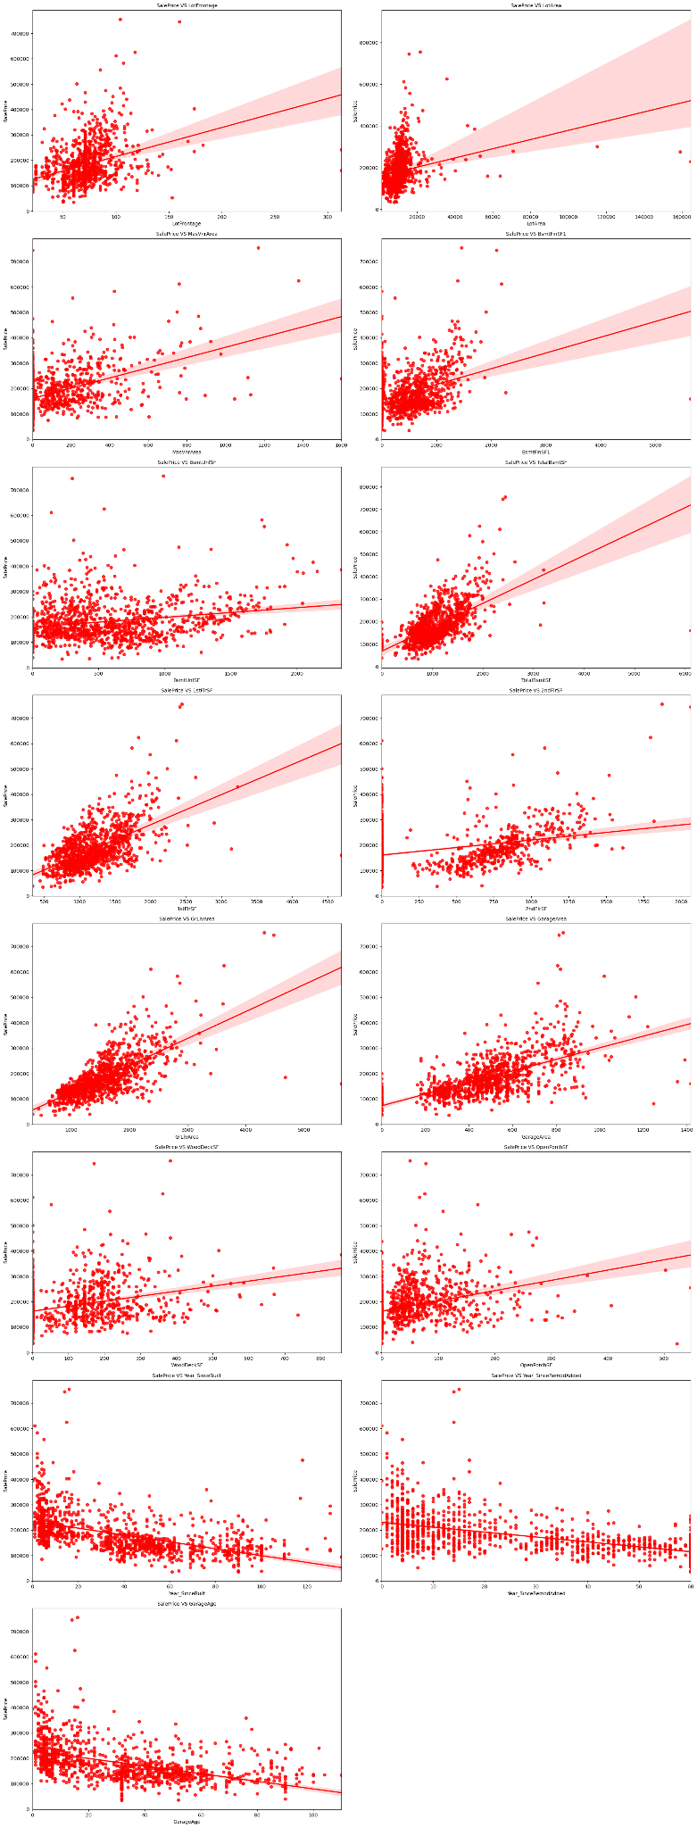
VISUALIZATION OF NUMERICAL COLUMNS

Slide 31
LotFrontage: As Linear feet of street connected to property is increasing sales are decreasing and the SalePrice is ranging between 0-3 lakhs.
LotArea: As Lot size in square feet is increasing sales are decreasing and the sale price is in between 0-4 lakhs.
MasVnrArea: As Masonry veneer area in square feet is increasing sales are decreasing and sale price is ranging between 0-4 lakhs.
BsmtFinSF1: As Type 1 finished square feet are increasing , sales are decreasing and the sale price is in between 0-4 lakhs.
OBSERVATIONS

Slide 32
VISUALIZATION OF NUMERICAL COLUMNS

Slide 33
BsmtUnfSF: As Unfinished square feet of basement area is increasing sales is decreasing and the sale price is in between 0-4 lakhs. There are some outliers also.
TotalBsmtSF: As Total square feet of basement area is increasing sales is decreasing and the sale price is in between 0-4 lakhs.
1stFlrSF: As First Floor square feet is increasing sales are decreasing and the sale price is in between 0-4 lakhs.
2nd FrSF: As Second floor square feet is increasing sales are increasing in the range 500-1000 and the sale price is in between 0-4 lakhs.
OBSERVATIONS

Slide 34
VISUALIZATION OF NUMERICAL COLUMNS

Slide 35
GrLivArea: As Above grade ground living area square feet is increasing sales is decreasing and the sale price is in between 0-4 lakhs.
GarageArea: As Size of garage in square feet is increasing sales is increasing and the sale price is in between 0-4 lakhs.
WoodDeckSF: As Wood deck area in square feet is increasing sales are decreasing and the sale price is in between 0-4 lakhs.
OpenPorchSF: As Open porch area in square feet is increasing sales is decreasing and the sale price is in between 0-4 lakhs.
OBSERVATIONS

Slide 36
VISUALIZATION OF NUMERICAL COLUMNS

Slide 37
Year_SinceBuilt: As Year_SinceBuilt is increasing sales are decreasing and the sale price is high for newly built buildings and the sales price is in between 0-4 lakhs.
Year_SinceRemodAdded: As Since Remodel date ,same as construction date if no remodeling or additions, sales are decreasing and the sale price is in between 1-4 lakhs.
GarageAge: As Year garage was built is increasing sales is decreasing and the sale price is in between 0-4 lakhs.
OBSERVATIONS

Slide 38
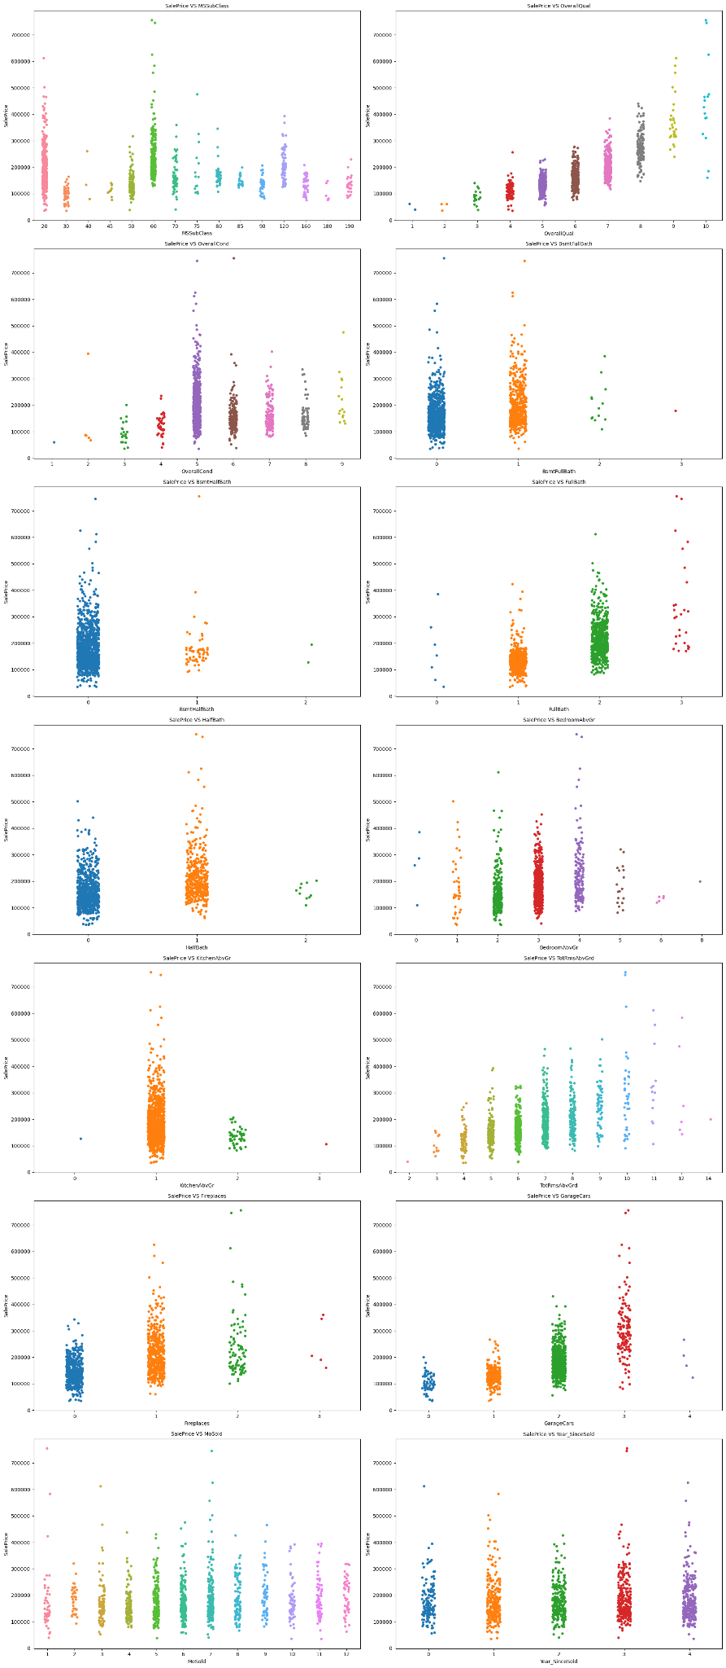
VISUALIZATION OF NUMERICAL COLUMNS

Slide 39
MSSuubClass: For 1-STORY 1946 & NEWER ALL STYLES(20) and 2-STORY 1946 & NEWER(60) types of dwelling the sales are good and SalePrice is also high.
OverallQual: As Rates the overall material and finish of the house is increasing linearly sales is also increasing And SalePrice is also increasing linearly.
OverallCond: For 5, Average overall condition of the house the sales is high and SalePrice is also high.
BsmtFullBath: For 0 and 1 Basement full bathrooms the sales as well as SalePrice is high.
OBSERVATIONS

Slide 40
VISUALIZATION OF NUMERICAL COLUMNS

Slide 41
BsmtHalfBath: For 0 Basement half bathrooms the sales as well as SalePrice is high.
FullBath: For 1 and 2 Full bathrooms above grade the sales as well as SalePrice is high.
HalfBath: For 0 and 1 Half baths above grade the sales as well as SalePrice is high.
BedroomAbvGr: For 2, 3 and 4 Bedrooms above grade ,does not include basement bedrooms, the sales as well as SalePrice is high.
OBSERVATIONS

Slide 42
VISUALIZATION OF NUMERICAL COLUMNS

Slide 43
KitchenAbvGr: For 1 Kitchens above grade the sales as well as SalePrice is high.
TotRmsAbvGrd: For 4-9 Total rooms above grade, does not include bathrooms, the sales as well as SalePrice is high.
Fireplaces: For 0 and 1 Number of fireplaces the sales as well as SalePrice is high.
GarageCars: For 1 and 2 Size of garage in car capacity the sales is high and for 3 Size of garage in car capacity the SalePrice is high.
OBSERVATIONS

Slide 44
VISUALIZATION OF NUMERICAL COLUMNS

Slide 45
MoSold: In between april to august for Month Sold the sales are good with SalePrice.
Year_SinceSold: For all the Year_SinceSold the sale price and sales both are same.
OBSERVATIONS

Slide 46
I have used bar plot for each of the categorical features, which shows the relationship of sale price with all the different categorical features.
And for the continuous numerical variables I have used reg plot to show the relationship between the numerical variable & target variable. And Strip plot for the discrete numerical variables & the target variable.
I found that there is a linear relationship between continuous numerical variable and SalePrice.
Analysis of Visualizations

Slide 47
Also after visualization, it was observed that both the train & test data sets have a number of outliers.
There was also skewness found in many variables.
Some variables showed high correlation towards the target variable, while others showed little to no correlation towards the target.
Analysis of Visualizations

Slide 48
In my datasets I found null values, outliers and also skewness.I used imputation method to replace null values.
To remove outliers I have used percentile method. And to remove skewness I have used yeo-johnson method.
Use of Pearson’s correlation coefficient to check the correlation between dependent and independent features.
Data Cleaning Steps

Slide 49
To encode the categorical columns I have use Ordinal Encoding.
Also I have used standardization to make sure there were no biases in both the datasets.
After that, I checked the VIF values of both the datasets and remove columns with extremely high VIF values, thereby solving the multicollinearity problem.
Finally, I proceeded to model building with all regression algorithms.
Data Cleaning Steps

Slide 50
Model Building
Since SalePrice was my target and it was a continuous column so this particular problem was regression problem. And I have used all regression algorithms to build my model.
By looking into the r2 score and cross validation score, I found ExtraTreesRegressor as a best model. Below are the list of regression algorithms I have used in my project.
Linear Regression Model
Decision Tree Regressor
KNearest Neighbors Regressor

Slide 51
Model Building
Support Vector Regression (SVR) Model
Random Forest Regressor
Gradient Boosting Regressor
Extra Trees Regressor
XGBoost Regressor

Slide 52
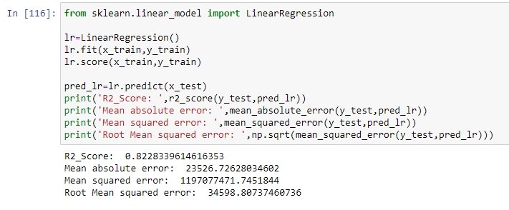
Linear Regression Model
The Linear Regression model gave us an R2 Score of 82.28 %.

Slide 53
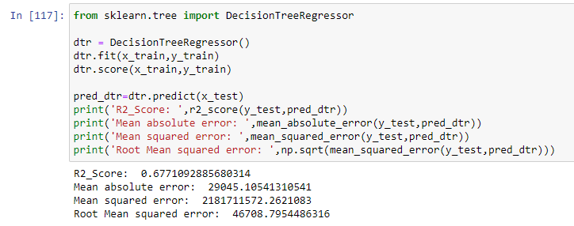
Decision Tree Regressor
The Decision Tree Regressor Model gave us a R2 Score of 67.71 %.

Slide 54
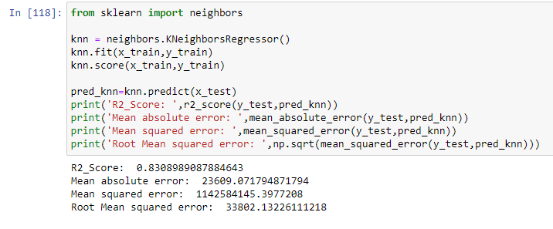
KNearest Neighbors Regressor
The KNearest Neighbors Regression Model gave us a R2 Score of 83.08 %.

Slide 55
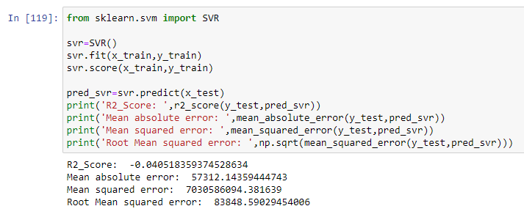
SVR Model
The SVR Model gave us a R2 Score of -4.05 %.

Slide 56
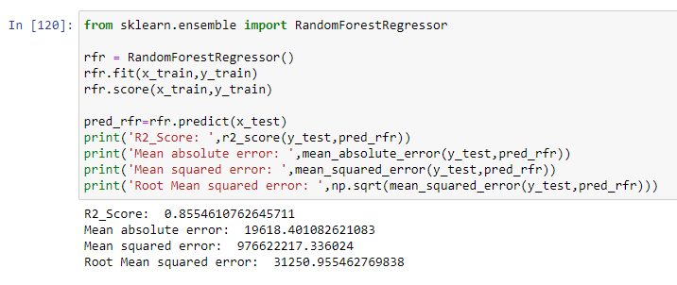
Random Forest Regressor
The Random Forest Regression Model gave us a R2 Score of 85.54 %.

Slide 57
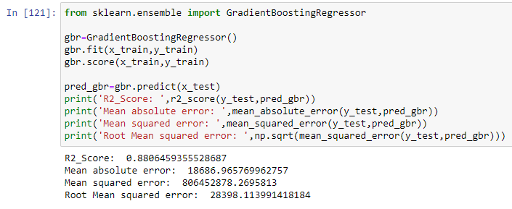
Gradient Boosting Regressor
The Gradient Boosting Regressor Model gave us a R2 Score of 88.64 %.

Slide 58
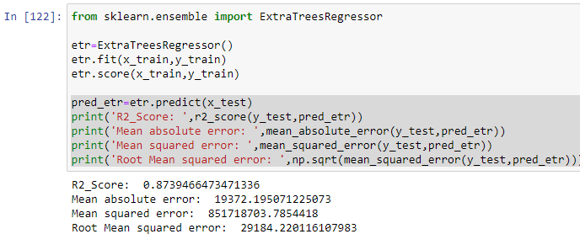
Extra Trees Regressor
The Extra Trees Regressor Model gave us a R2 Score of 87.39 %.

Slide 59
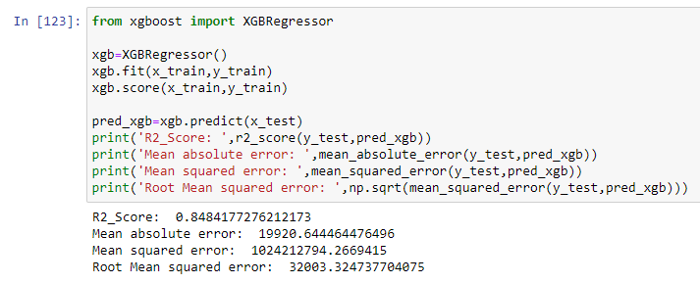
XGBoost Regressor
The XGBoost Regressor Model gave us a R2 Score of 84.84 %.

Slide 60
Cross Validation Scores
The cross validation score of the Linear Regression Model is 80.14 %.
The cross validation score of the Decision Tree Regressor Model is 65.40 %.
The cross validation score of the KNearest Neighbors Regression Model is 73.74 %.
The cross validation score of the SVR Model is -6.17 %.
The cross validation score of the Random Forest Regressor Model is 83.23 %.
The cross validation score of the Gradient Boosting Regressor Model is 82.73 %.
The cross validation score of the Extra Trees Regressor Model is 83.49 %.
The cross validation score of the XGBoost Regressor Model is 83.49 %.

Slide 61
Hyper Parameter Tuning
Since the R2 Score & Cross Validation Score are both the second highest in Extra Trees Regressor we shall consider it for hyper parameter tuning. We will use GridSearchCV for hyper parameter tuning.
After Hyper Parameter Tuning, we have got a better R2 score of 87.82 %.

Slide 62
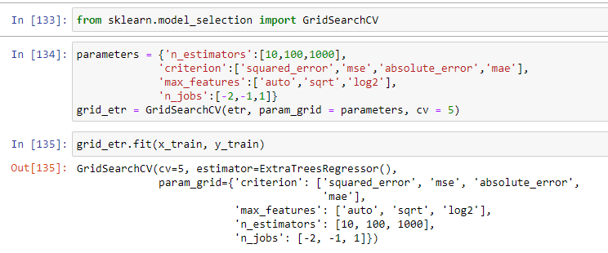
Hyper Parameter Tuning

Slide 63
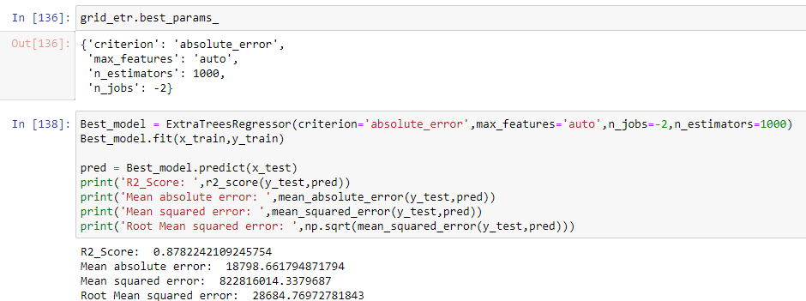
Hyper Parameter Tuning

Slide 64
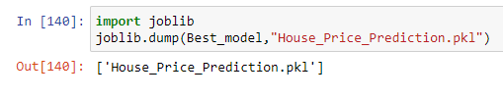
Saving the model and predictions using saved model
Saving the best model.

Slide 65
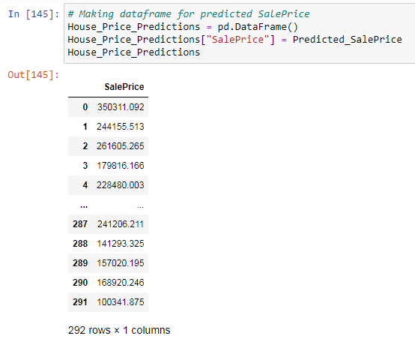
Saving the model and predictions using saved model
These are the predicted sale price of the house for the test data set. We have created a data frame for the predicted result which is as below.

Slide 66
Conclusion
In this project report, we have used machine learning algorithms to predict the house prices.
We have mentioned the step by step procedure to analyze the dataset and find the correlation between the features.
Thus, helping us select the features which are not correlated to each other and are independent in nature.
These feature sets were then given as an input to 8 algorithms.
We calculated the performance of each model using different performance metrics and compared them based on these metrics.
Then we have also saved the data frame of predicted prices of the test dataset.

